Slide 1
Laboratory Earthquake Prediction
Xuan Qin, Ph.D.

Slide 2
Who should care

Slide 3
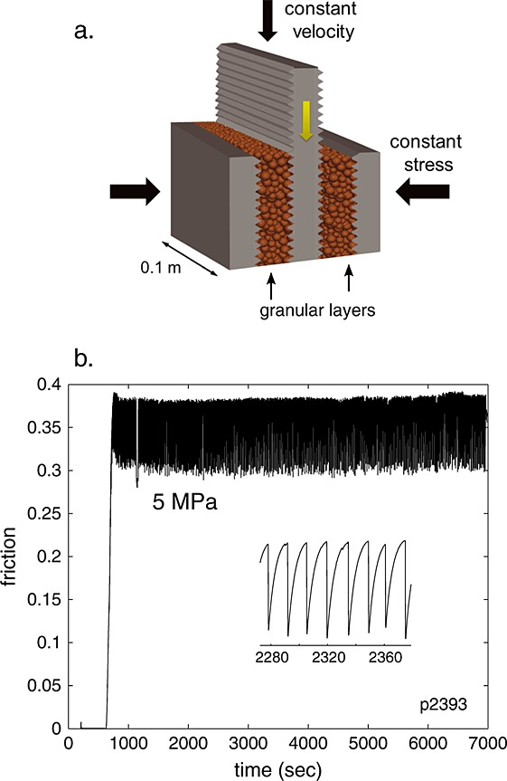

Slide 4
Feature

